Slide 1
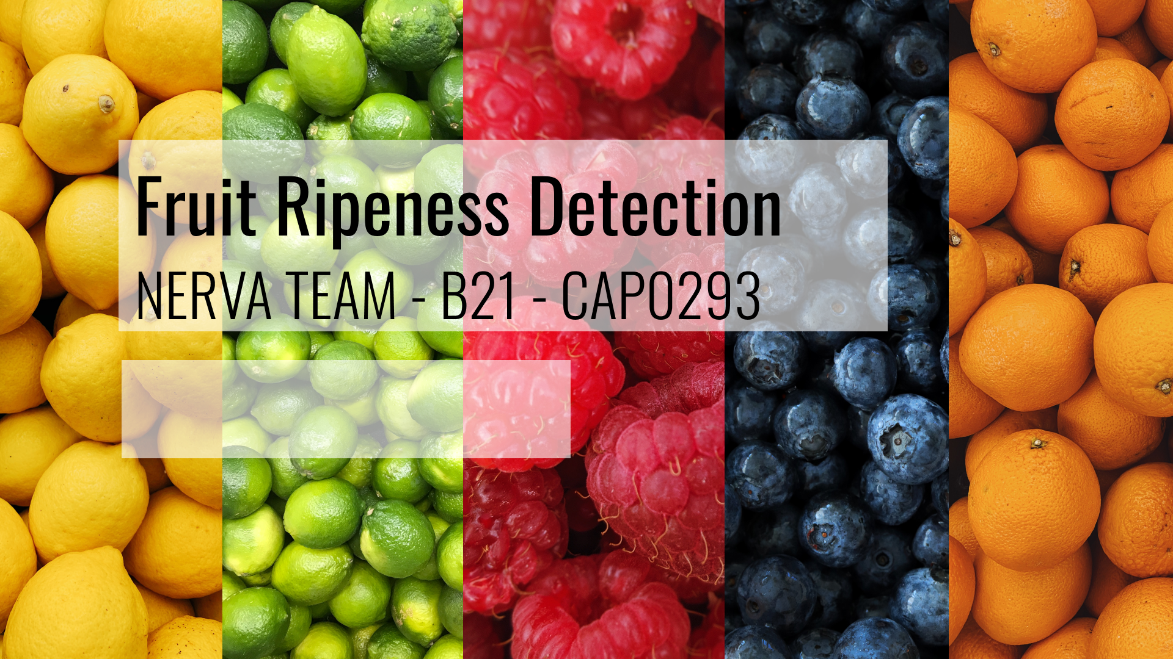


Slide 2
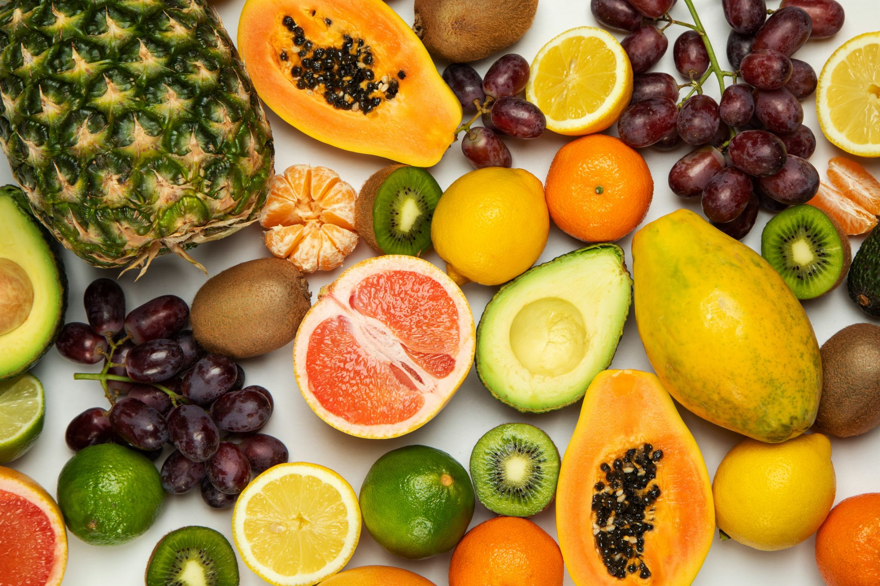
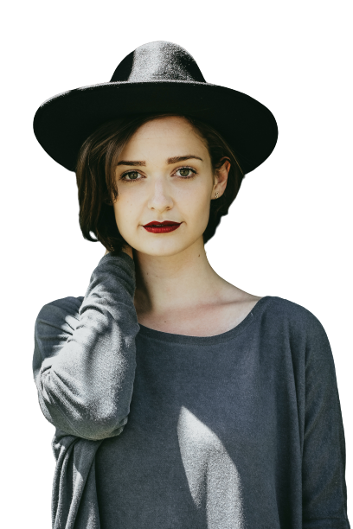
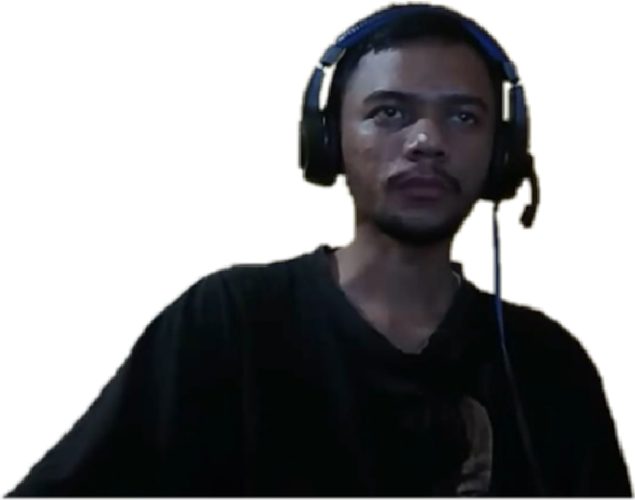
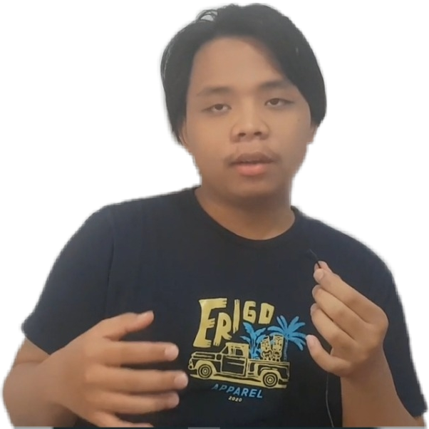
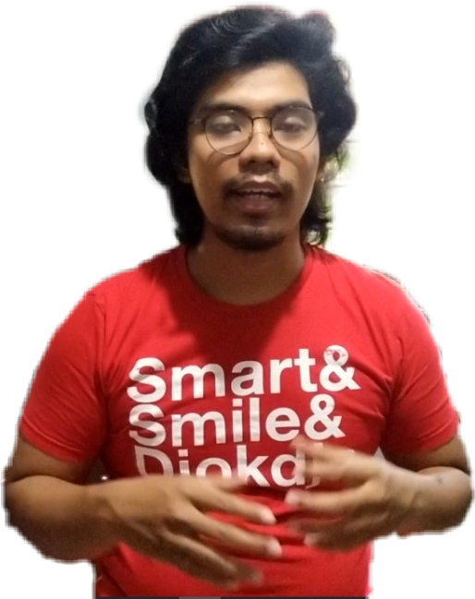
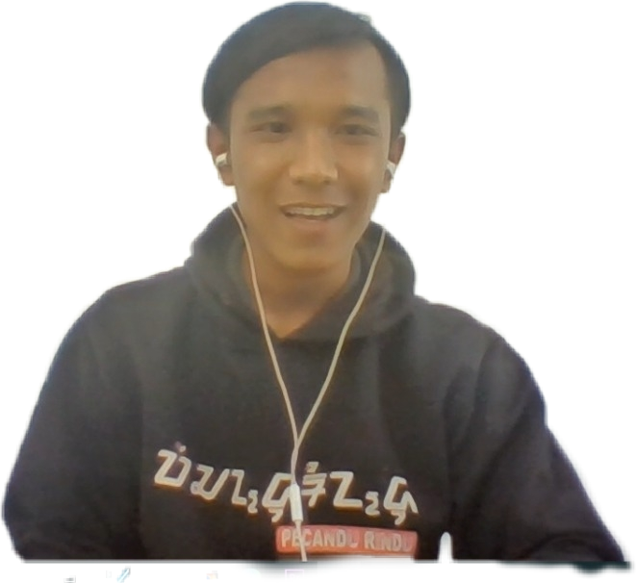
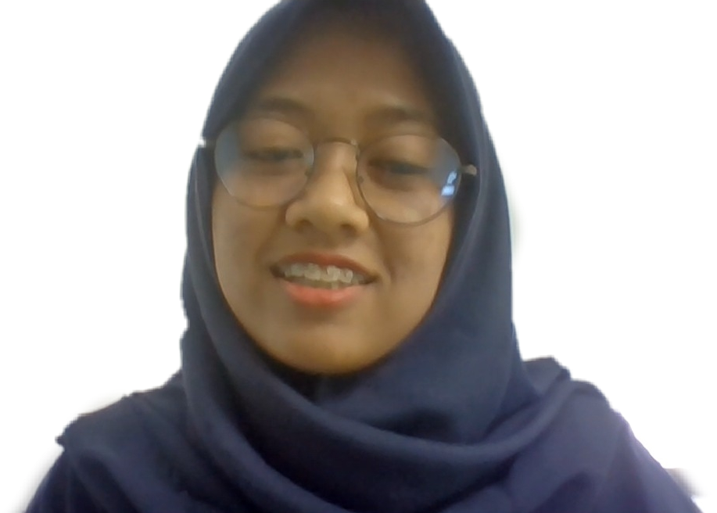
MEET THE TEAM MEMBER
Raynold Panji Z
C2462305
Alif Luqman Kahfi
M0020131
Pebi Pebriansah
A2462302
Rivaldo Yoseph
M0121223
Anita Azura
A2462309
Mutia
C2472338

Slide 3
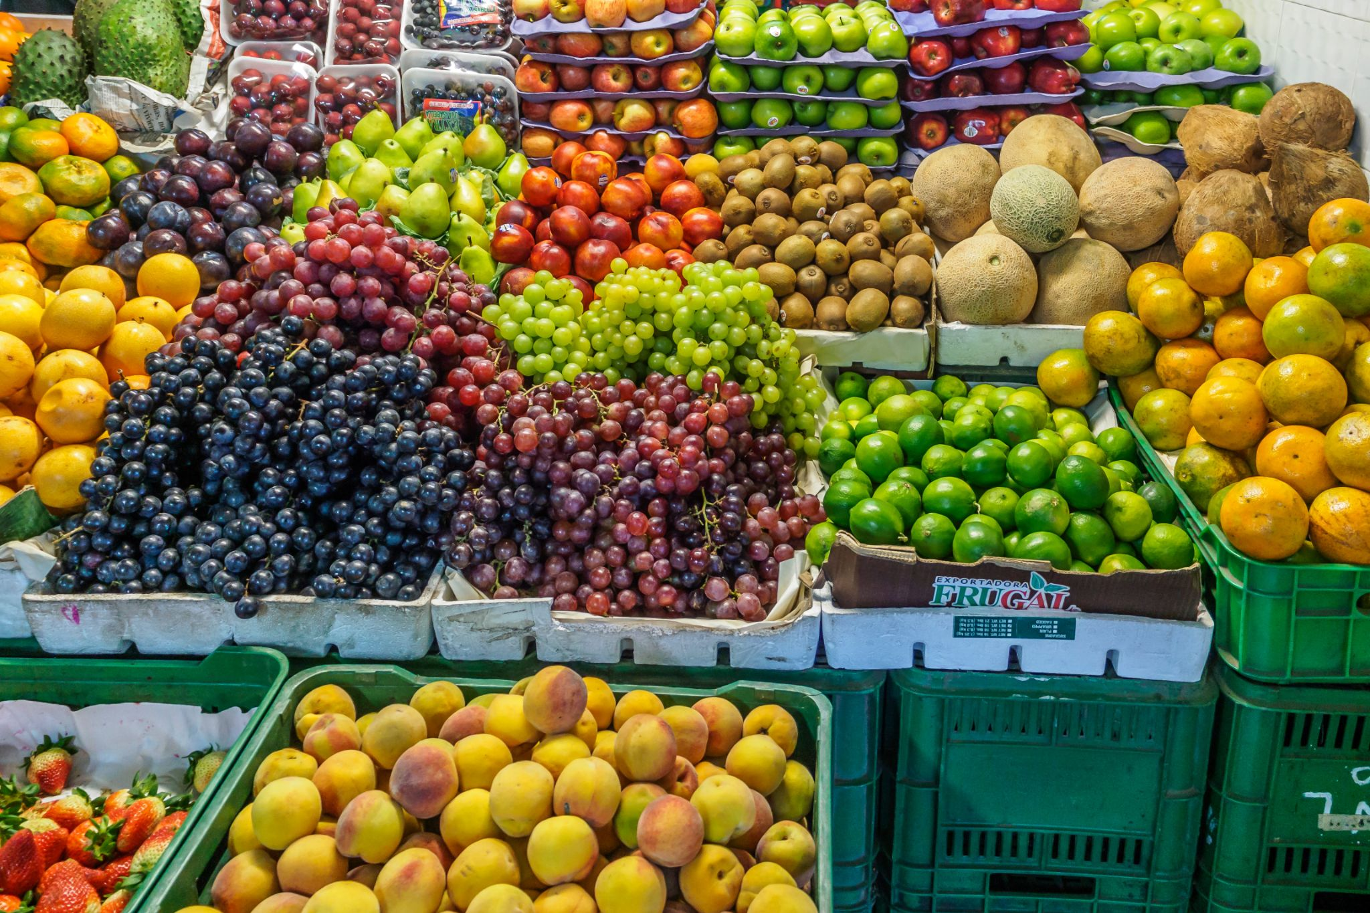
BACKGROUND STORY
Fruit is the food we eat most often. Fruit has many nutrients contained in it which is good for us.
But sometimes we find it difficult to determine whether the fruit is ripe or not by its colour
So, we come with a simple idea. To give an additional reference for fruit buyer
Notes:
Fruit is the food we eat most often. Fruit has many nutrients contained in it which is good for us. but sometimes we like to be deceived by the color of the fruit.

Slide 4
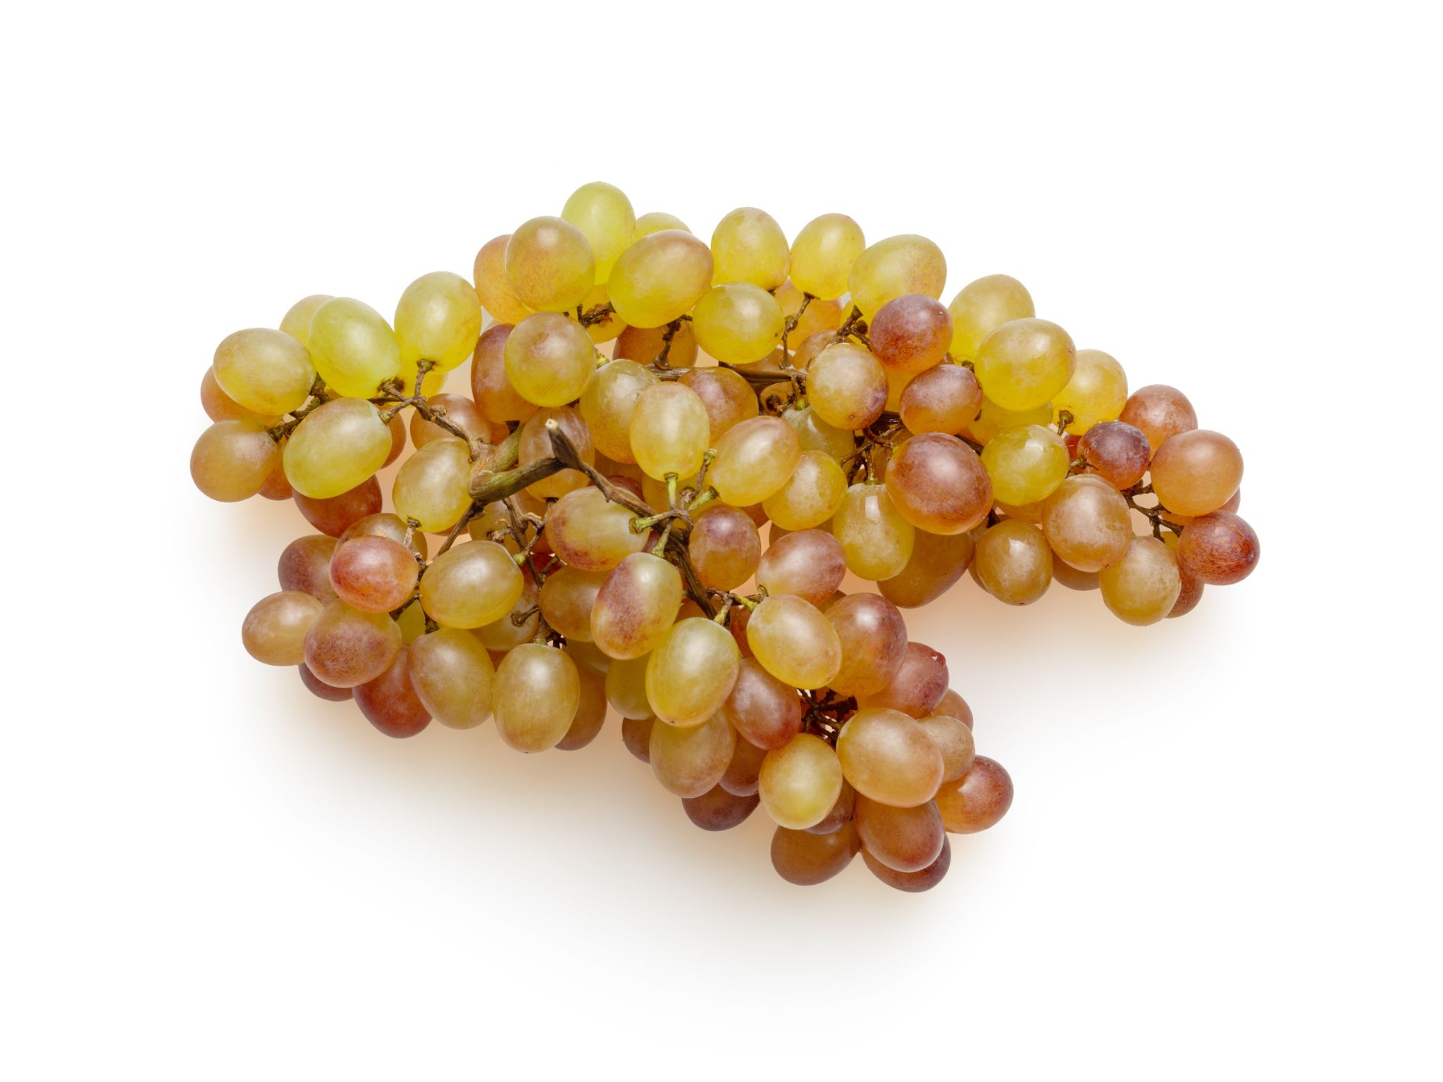
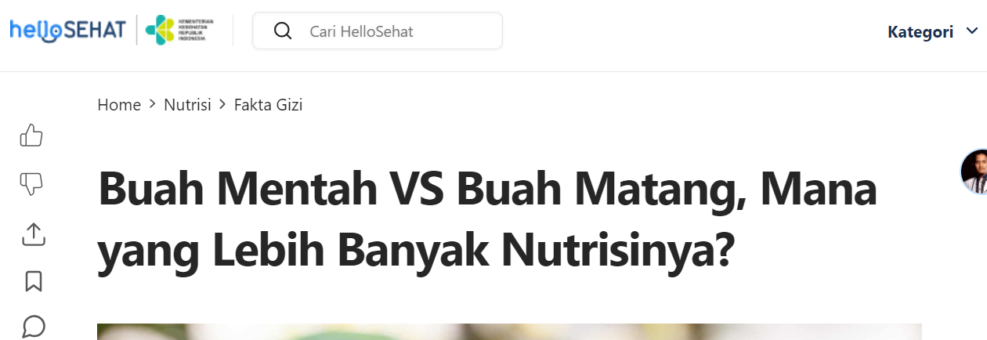
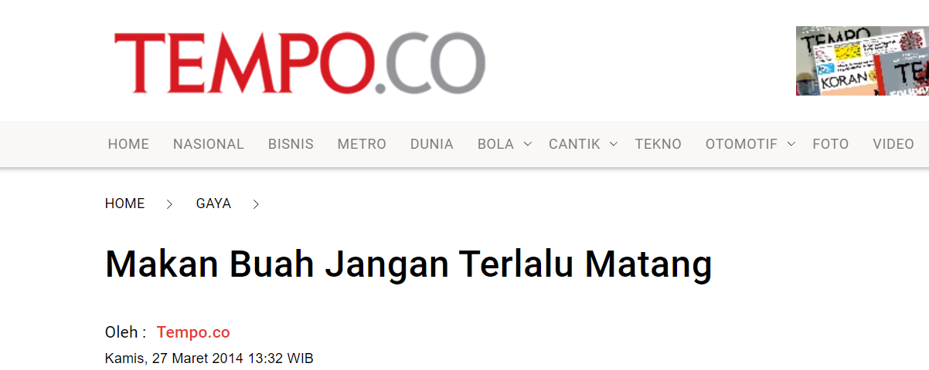
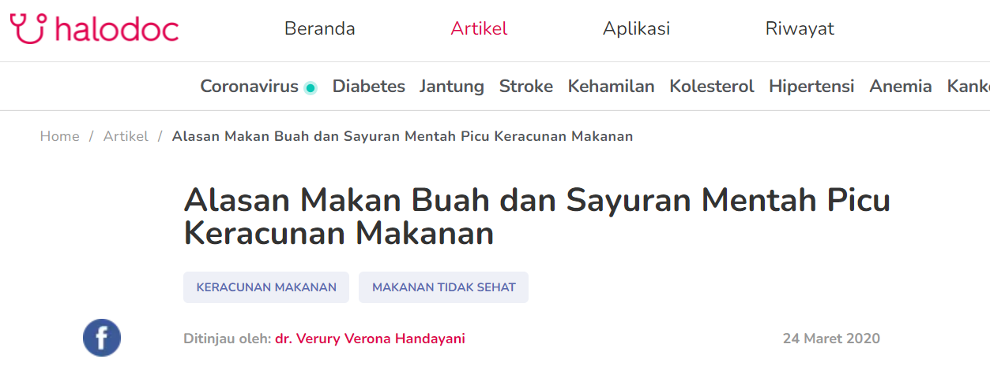
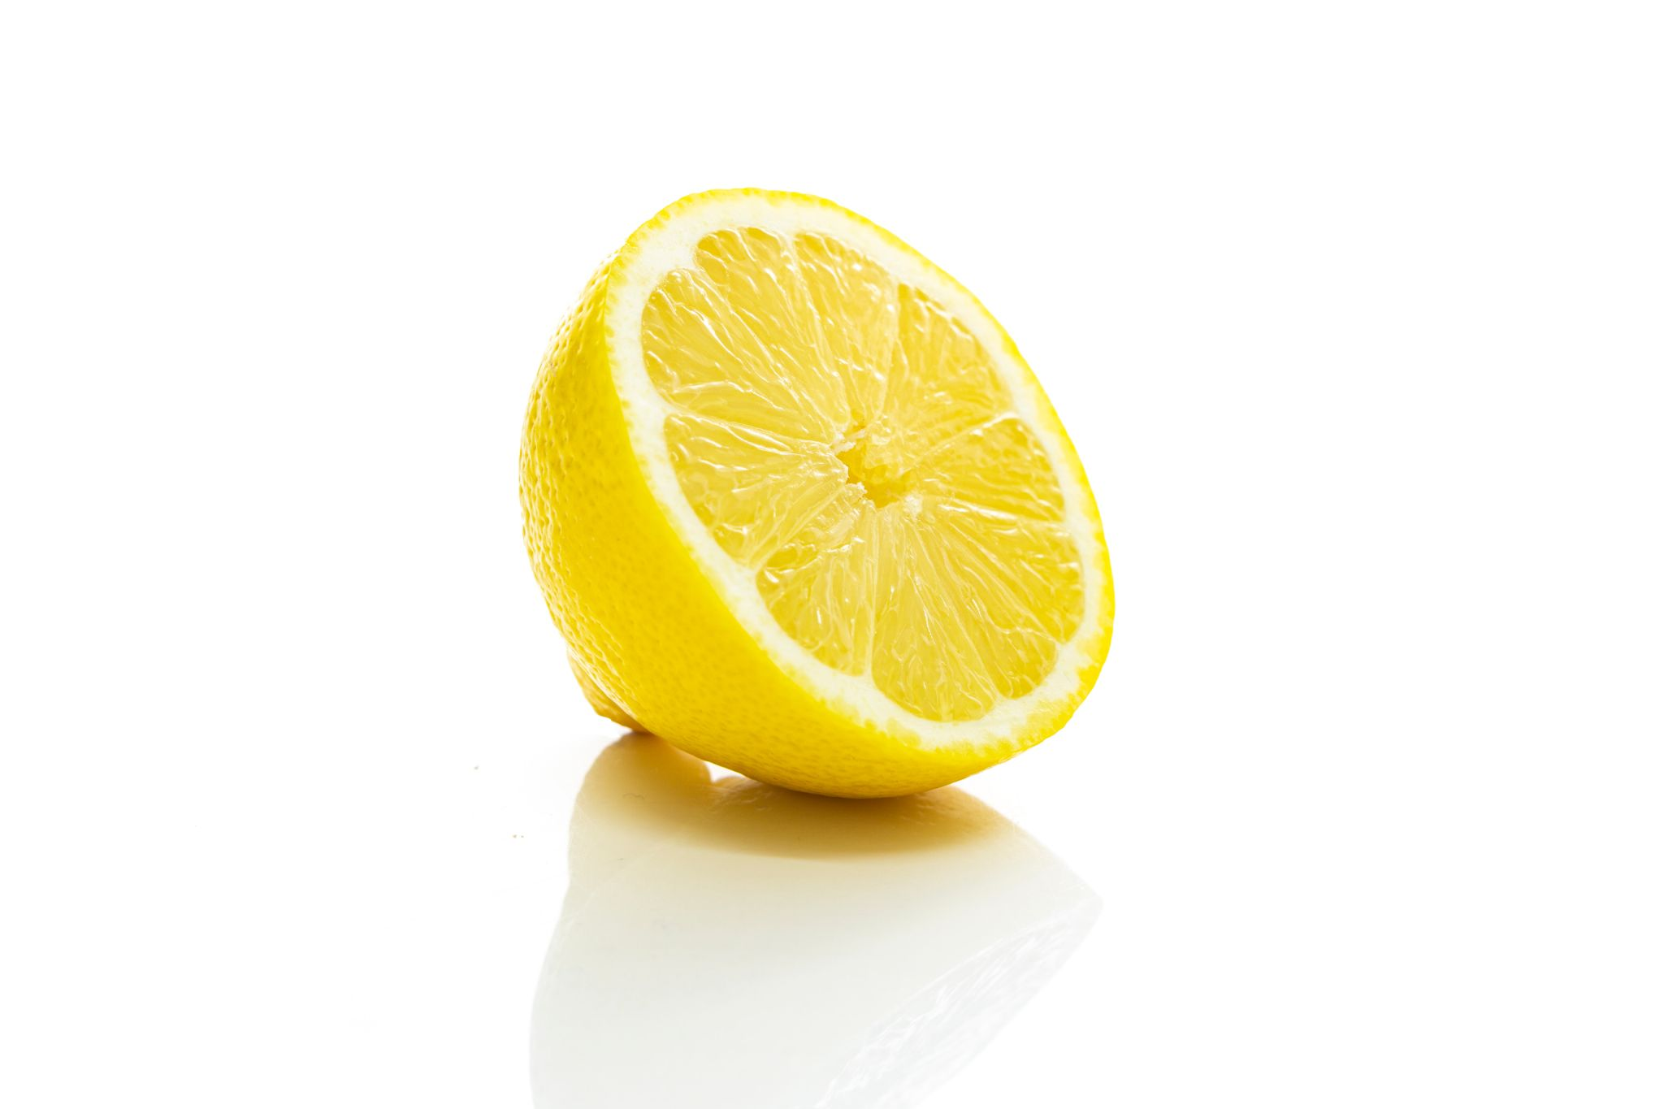
Background Story
Notes:
Bananas are yellow when ripe. but what kind of yellow?
It's yellow, but there's still some green. is this ripe? we will find out.
because ripe fruit will have more complete nutrition for us. Overripe fruit is also not good for us because it contains a lot of sugar. and what is dangerous is also that immature fruit sometimes has substances that are harmful if we eat it

Slide 5
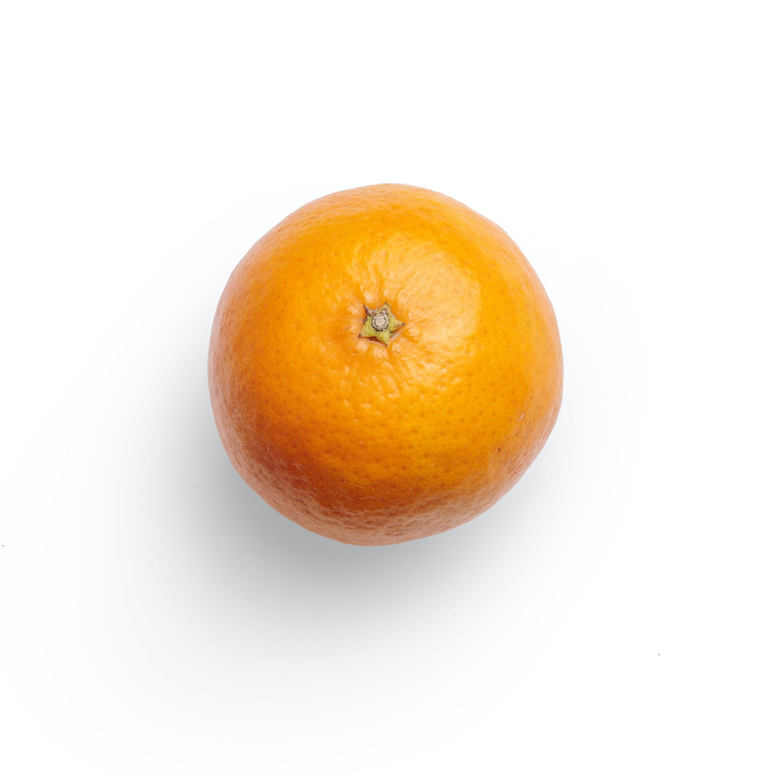
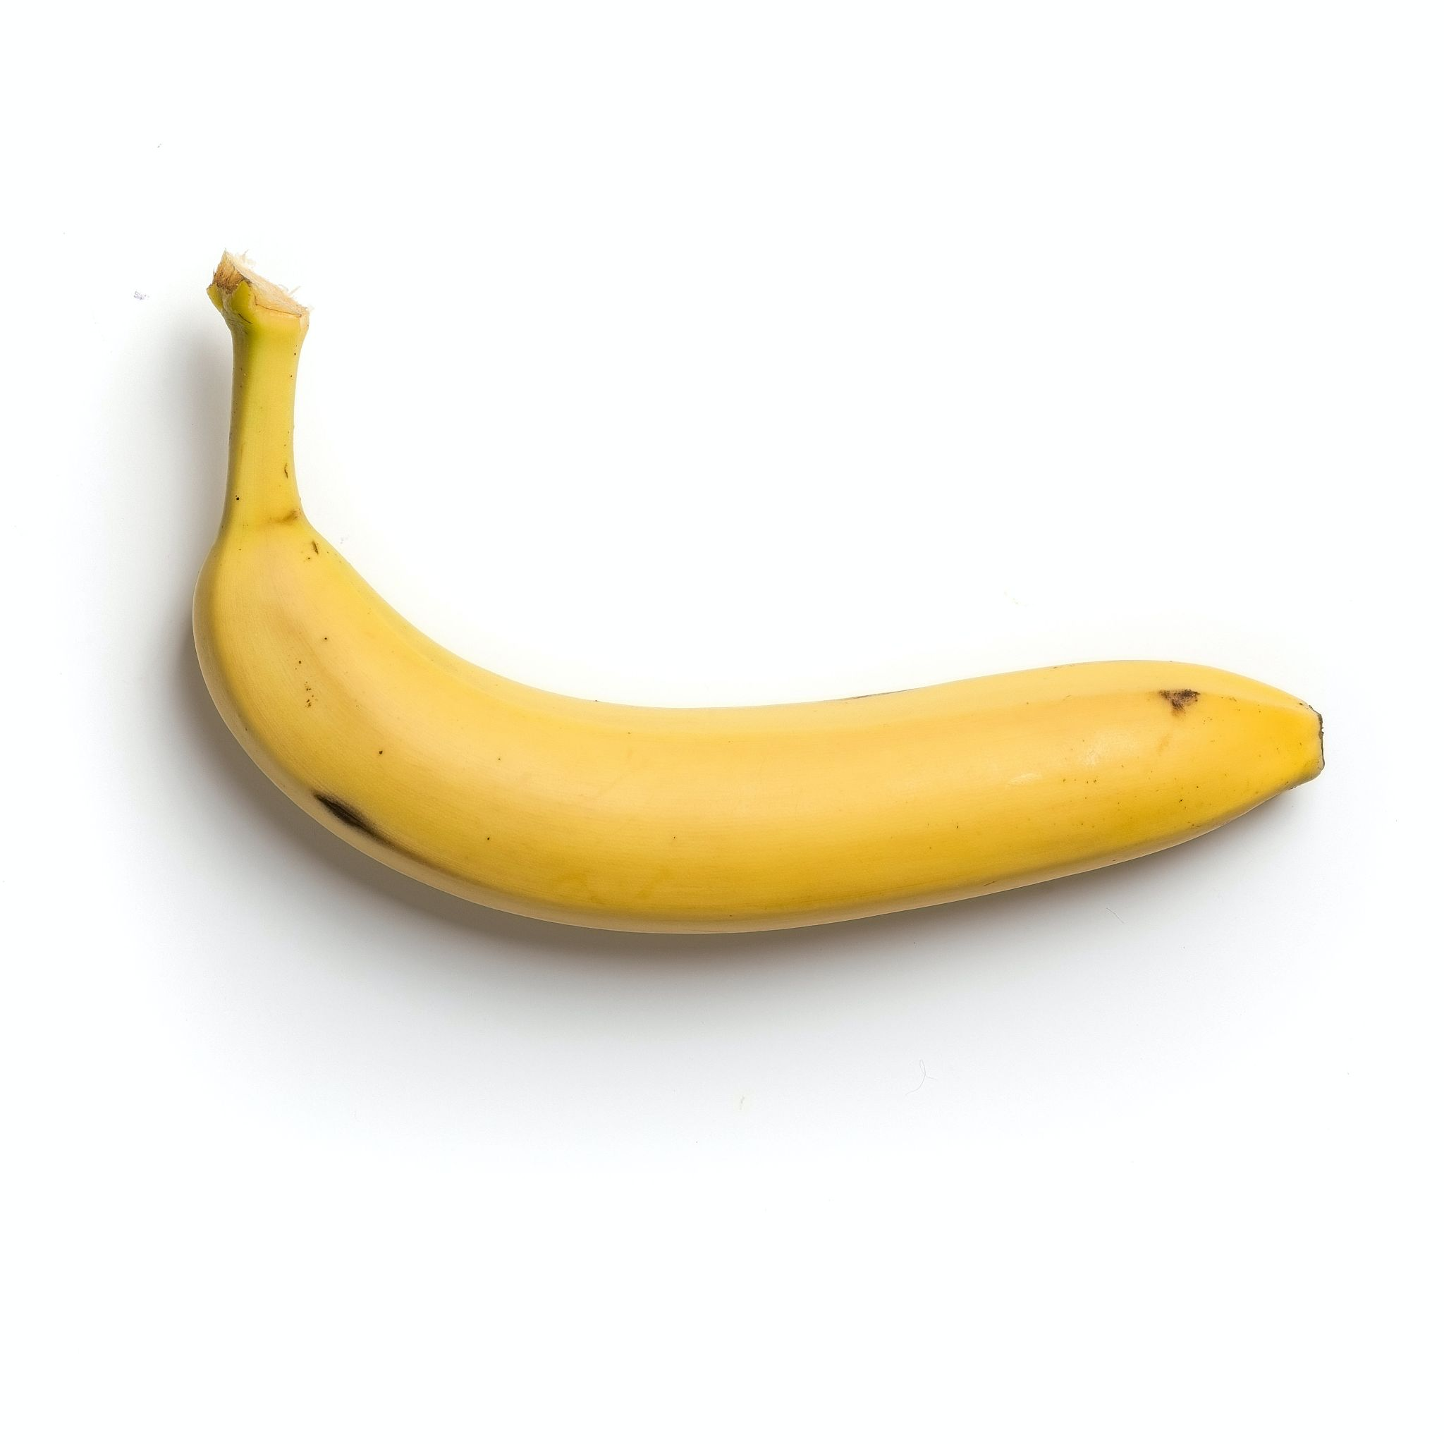
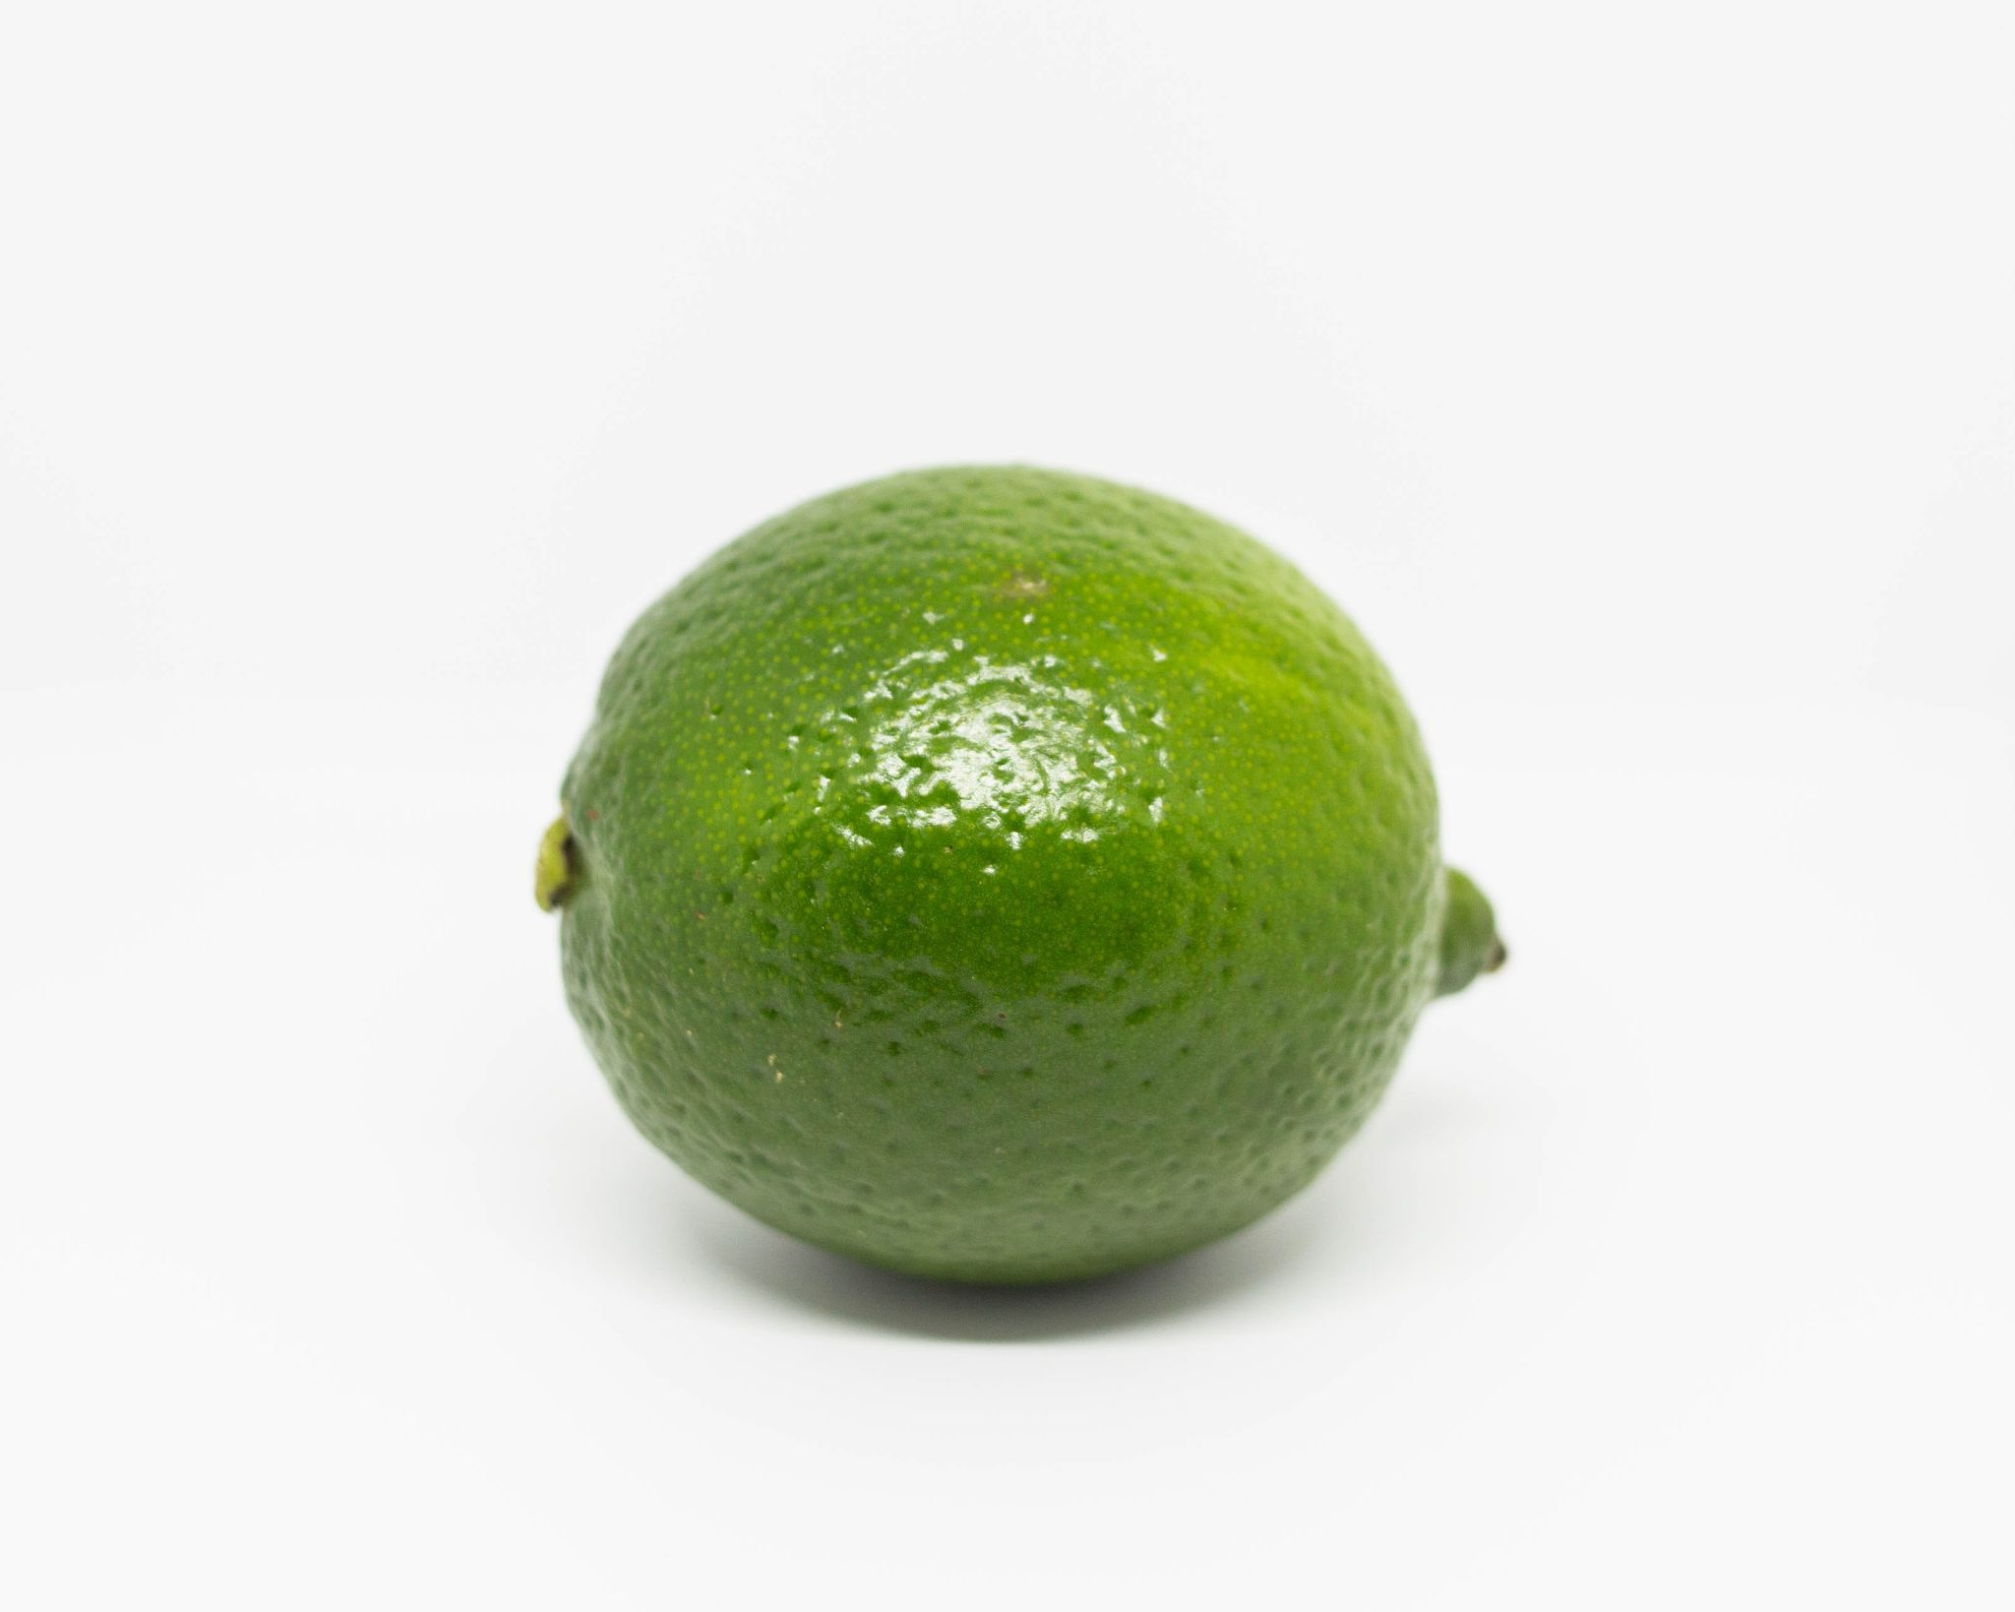
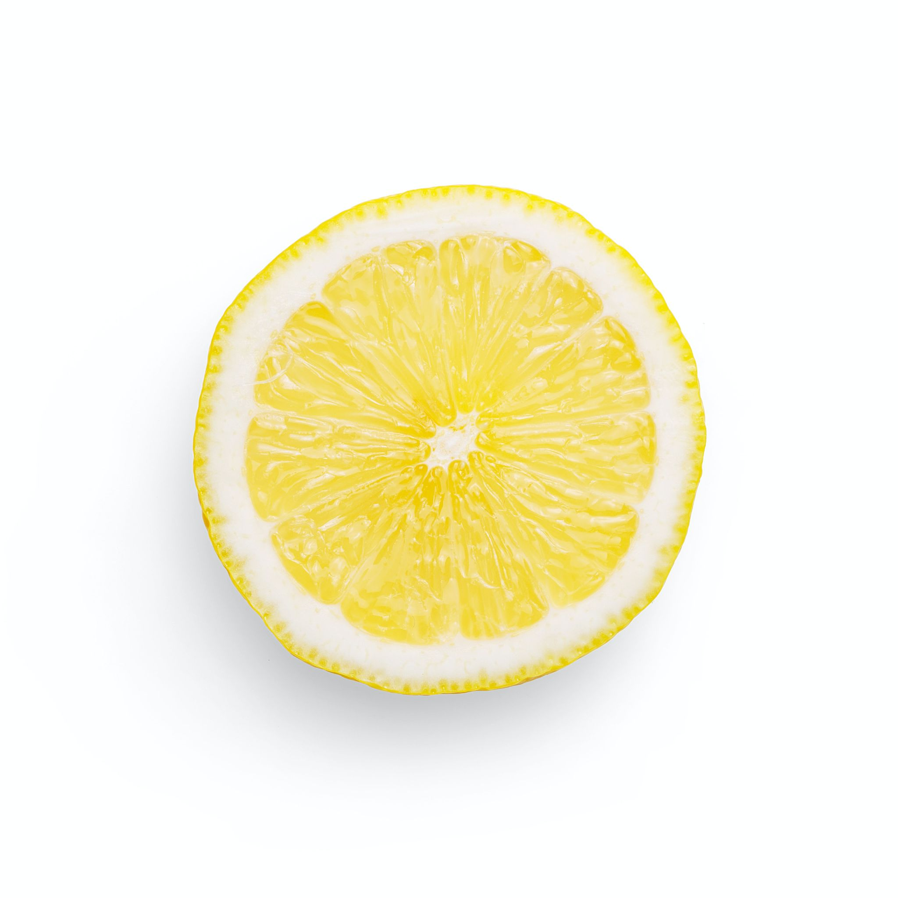
So our goal in working on this project is so that people can consume fruits at the right time when the nutrients are optimal for our bodies. Determined by the colour.
We want our product deliver a same prupose as a ensiklopedia for fruit but using machine learning to ease the user interface, with android for the applications
Notes:
so our goal in working on this project is so that people can consume fruits at the right time when the nutrients are optimal for our bodies.

Slide 6
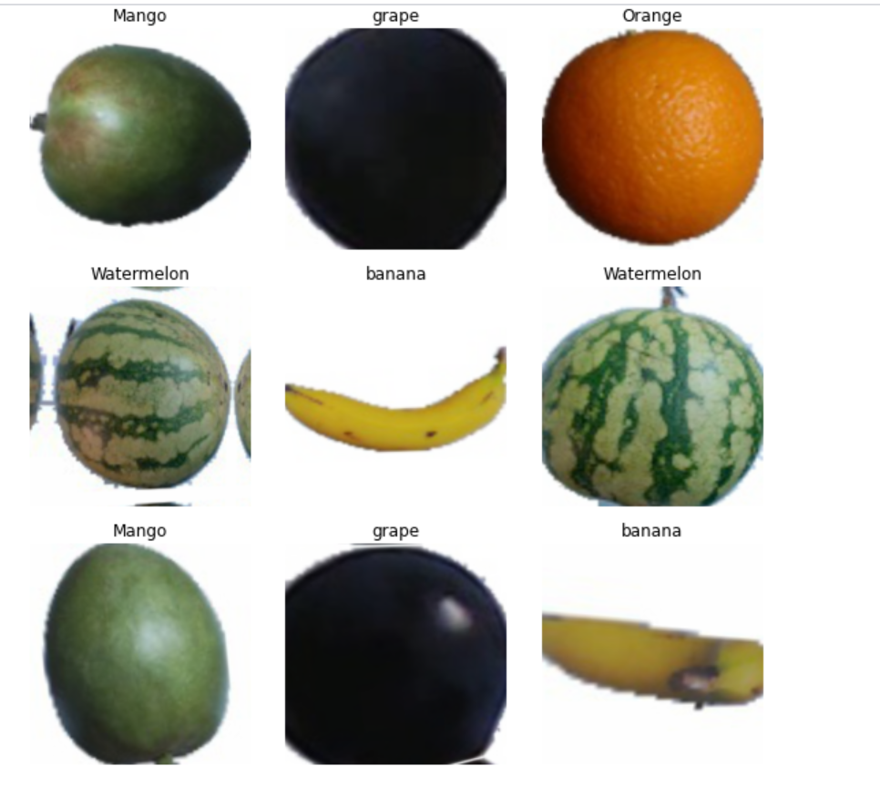
Dataset
Manggo
ML 1 DATASET
Watermelon
Banana
Grape
Orange
Apple
Dataset with 6 classes of fruit
Source : https://www.kaggle.com/moltean/fruits

Slide 7
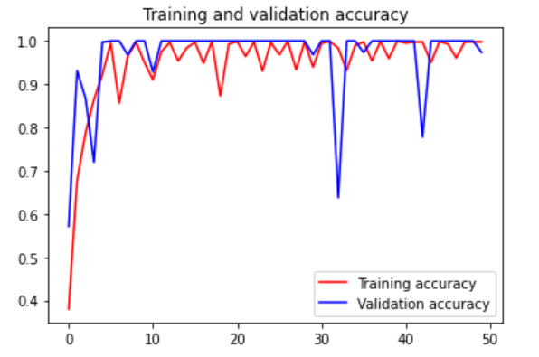
CNN Model
97,8 % Accuracy
727 ms for detection

Slide 8
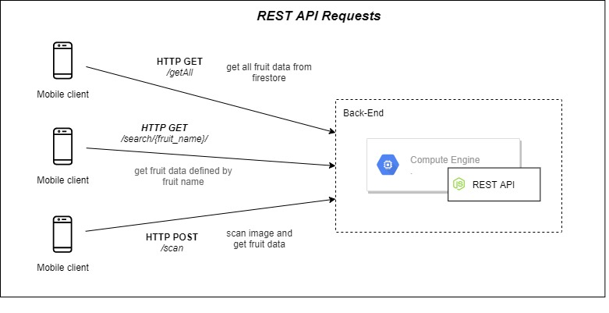
Cloud Computing

Slide 9
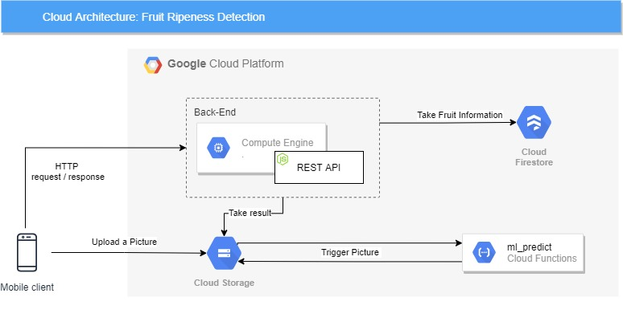
Cloud Computing

Slide 10
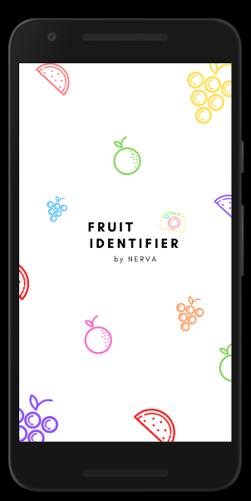
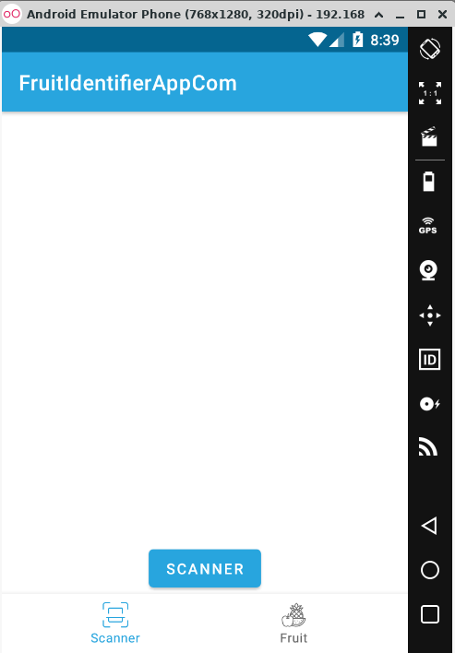
Mobile Developer
Splash Screen
Unique and interesting splashscreen.
Splashscreen to prepare the application to prepare its needs.
Scanner
Scanner for users to be able to scan the fruit in front of them.

Slide 11
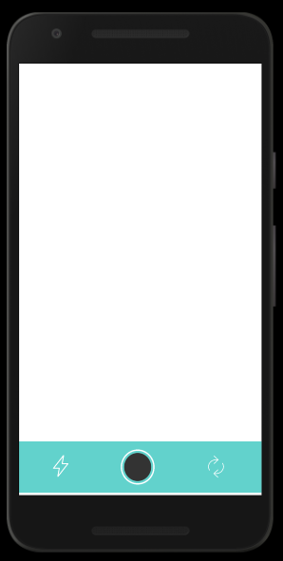
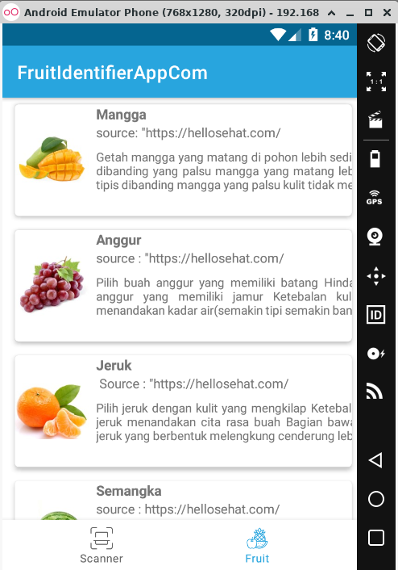
Mobile Developer
Camera Android
Using the default camera from android.
List Fruit
List of fruit lists for users who don't want to scan photos.

Slide 12
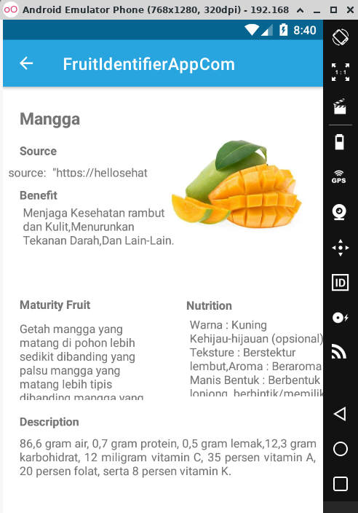
Mobile Developer
Detail Fruit
The description of the fruit they scan or select, has some info about the fruit guys.

Slide 13
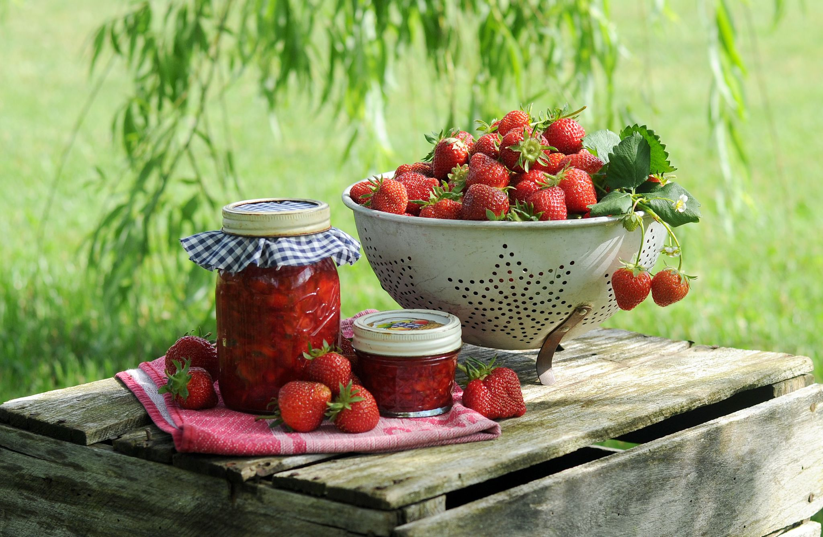
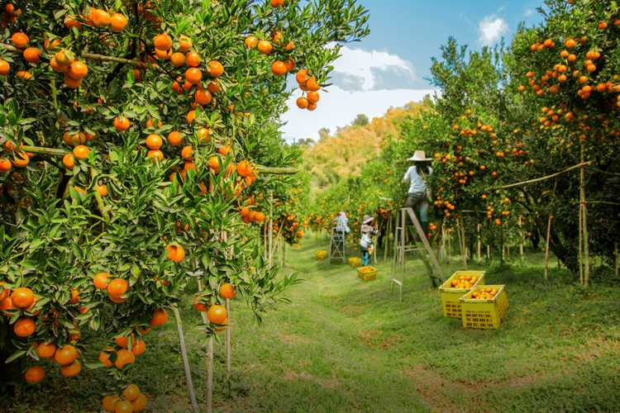
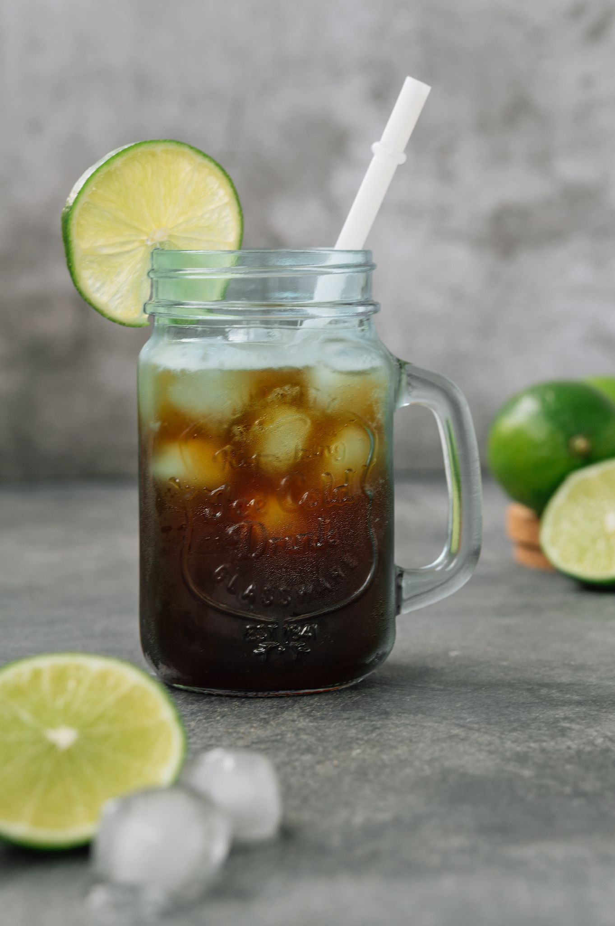
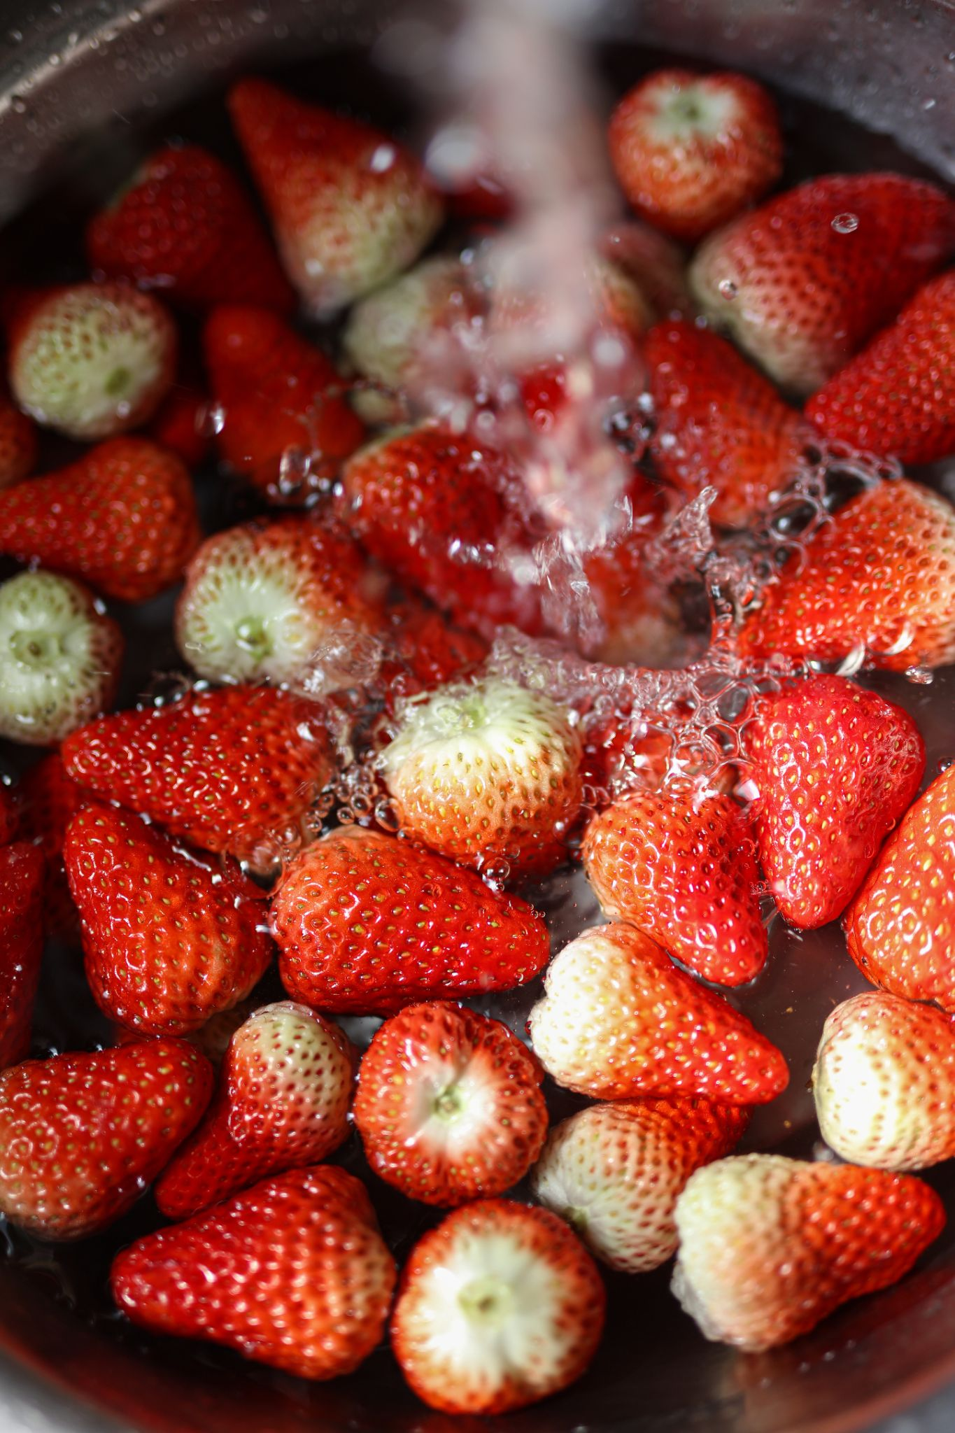
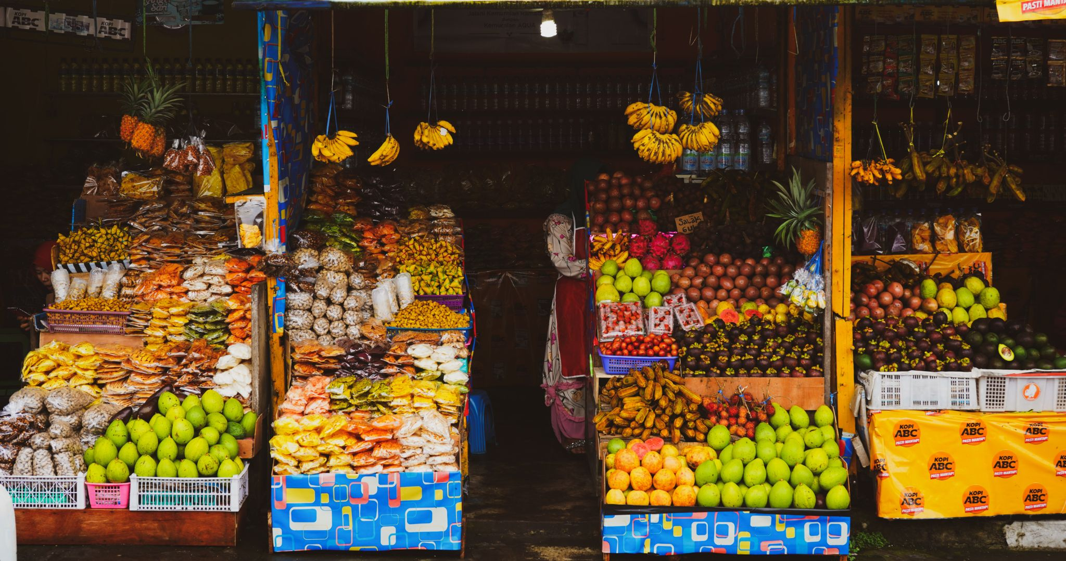
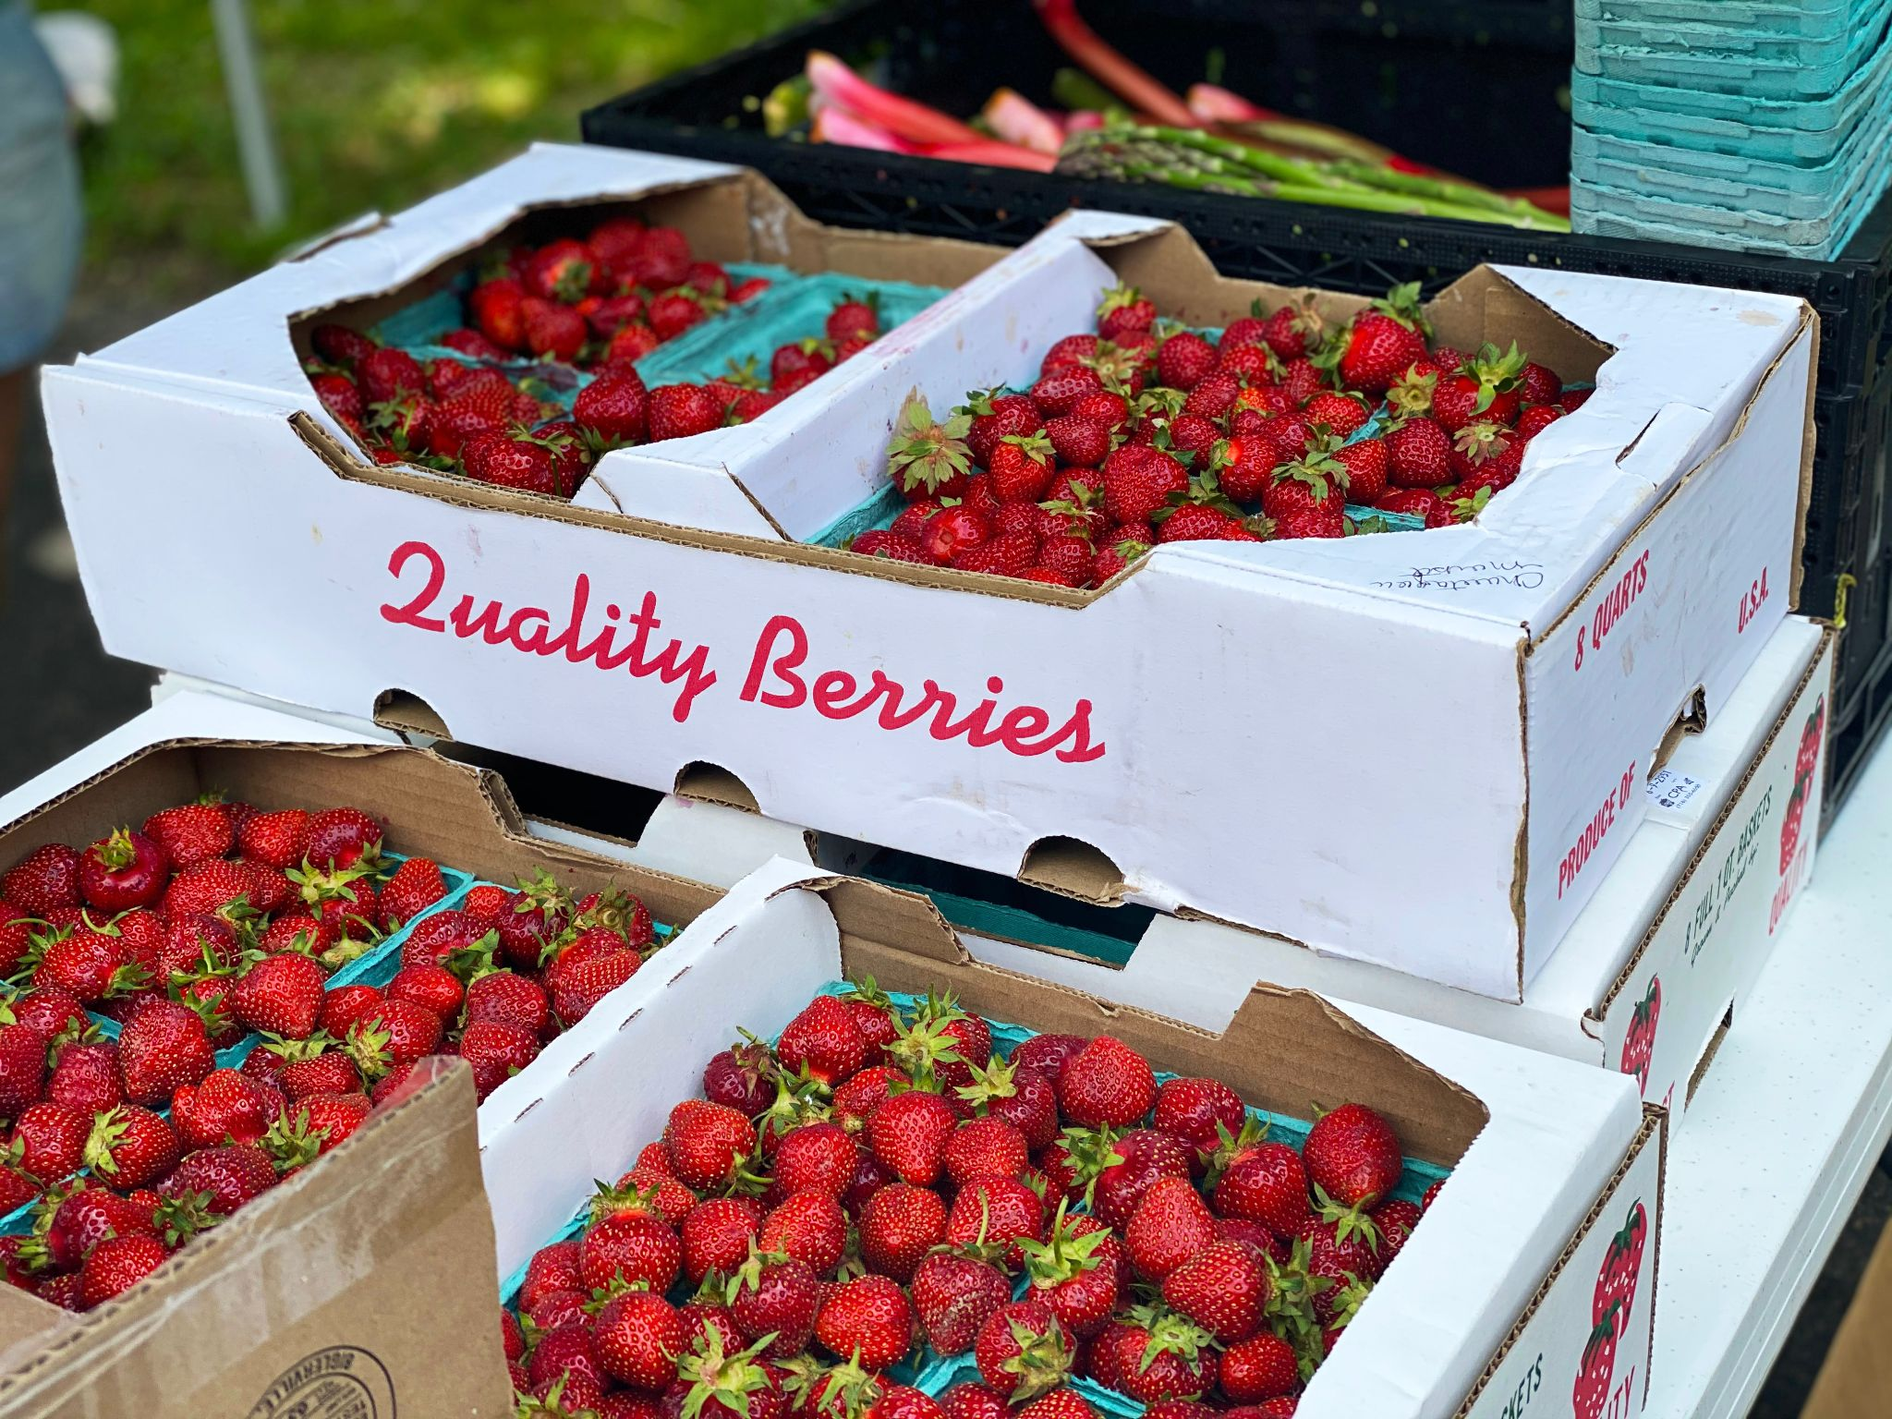
Market Segmentation
Fruit Processed Consumption
Fruit Plantation
Market User
Fruit-based Industry

Slide 14
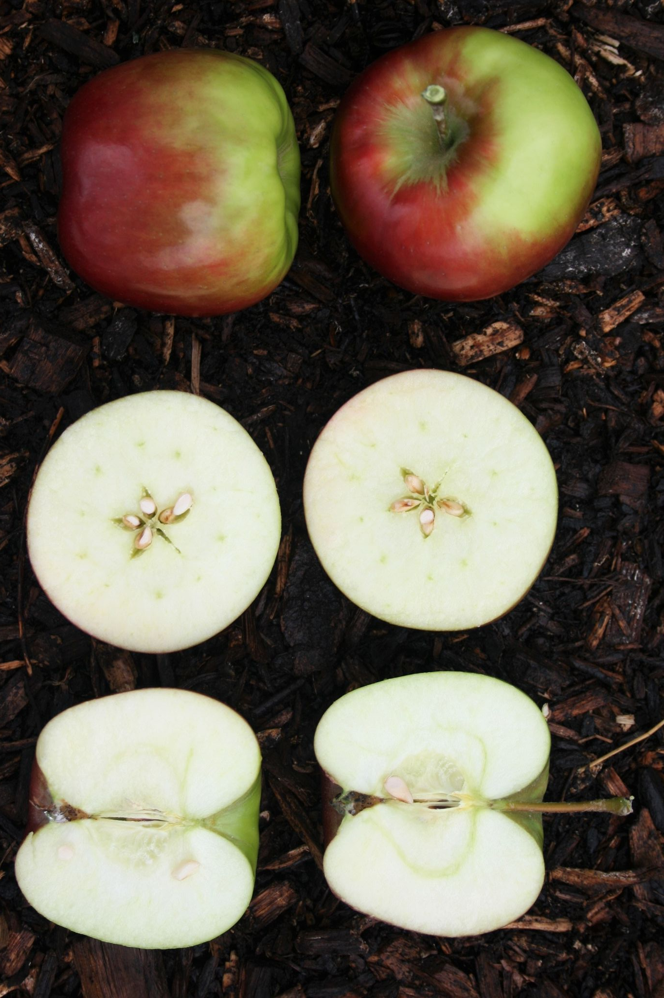
CONLUSION
Conclusion
Our team conclusion is that we achieved our target that we give an additional references to people or segmented user that is ease and reliable to use.
Along the way we counter manya chelengged but in the end we managed to completed this capstone project as the result we not fully achieved our target but as the product we want to have a device integrated with the cloud that have same build as the application, just for the scale up
In the end we thank all the mentor and bangkit program cause giving us a change to made this project come to this.

Slide 15
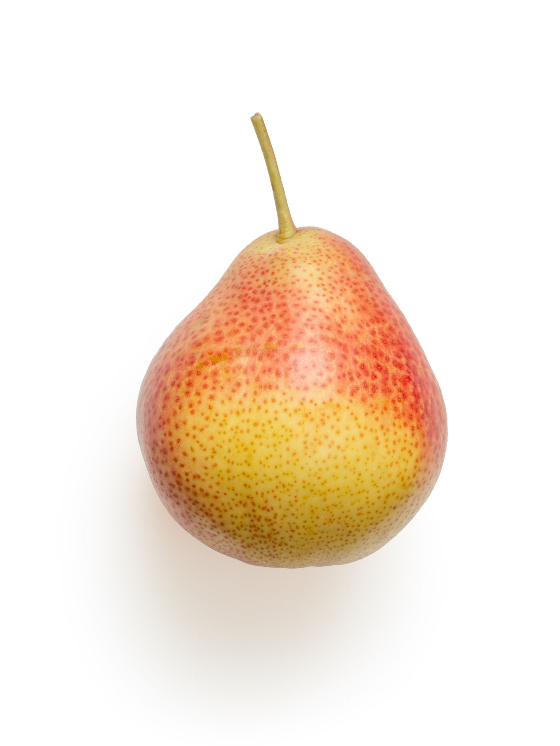
Thank You !
Nerva Team
B21 - CAP0293
Terima kasih!

